Slide 1
OBSERVING THE RELATIONSHIP BETWEEN VOLTAGE AND CURRENT WITH HIGH POWERED LASERS UNDER DIFFERENT TEMPERATURES
By: Natalie Caro
Data Collected by: Aditi Patel & Natalie Caro
May 6, 2019

Slide 2
Outline
Introduction
Optical layout
Data
Results
Conclusion
References

Slide 3
Introduction
Laser: Light Amplification by Stimulated Emission of Radiation
Has only one wavelength, moves in one direction, and is monochromatic.
Lasers are in use everywhere:
DVDs
Cutting steel in factories
Scanning labels in supermarkets
Performing surgery in hospitals
Solid-state lasers are lasers whose outputs range in wave- length from roughly 170 nm to 3900 nm.

Slide 4
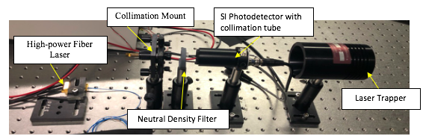
Optical Layout

Slide 5
Data with and without Nd filter
Current Threshold: 500mA
Saturation from detector: 0.6V
The ND filter made it possible to measure the gradual increase from the current threshold to the level of saturation.
Current threshold

Slide 6
Data Time vs temperature
Styrofoam
Current is at a constant 2000mA.
Recorded temperature every 30s for 300s
Temperature increases the longer the laser is on.

Slide 7
Data Time vs voltage
Current is at a constant 2000mA.
Recorded laser power every 30s for 300s
Power decreases the longer the laser is on.

Slide 8
Results Temperature vs Power
Combined previous two graphs
Power does decrease as temperature increases
Error

Slide 9
Results Differences of thermal stability
Set the laser to 45C
Current Threshold: 1000mA
The overall voltage is weaker at a higher temperature than with a cooler temperature.
T=22C
Current threshold
T=45C
Current threshold

Slide 10

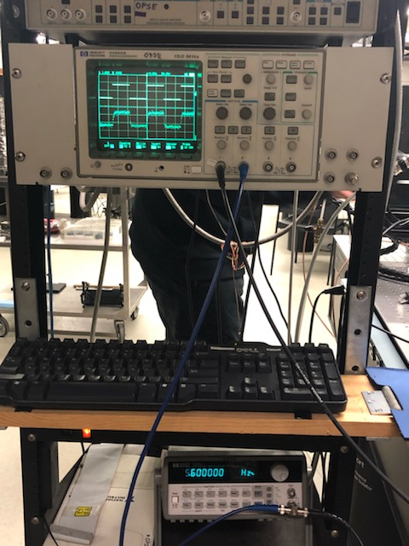
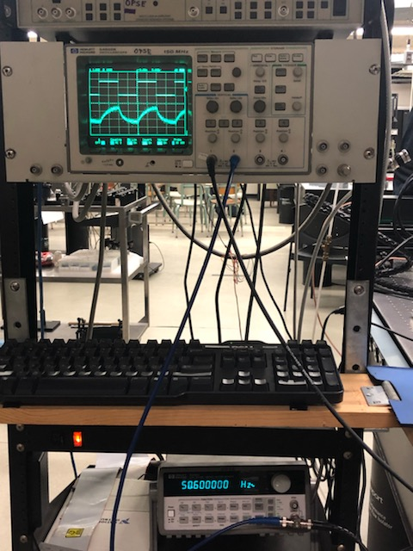
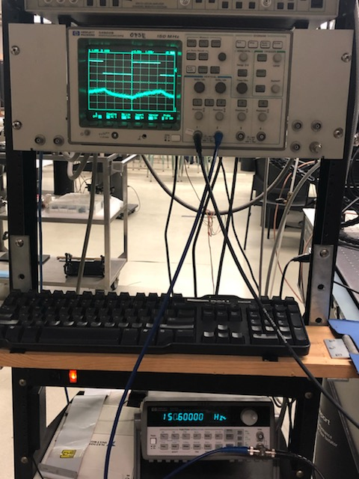
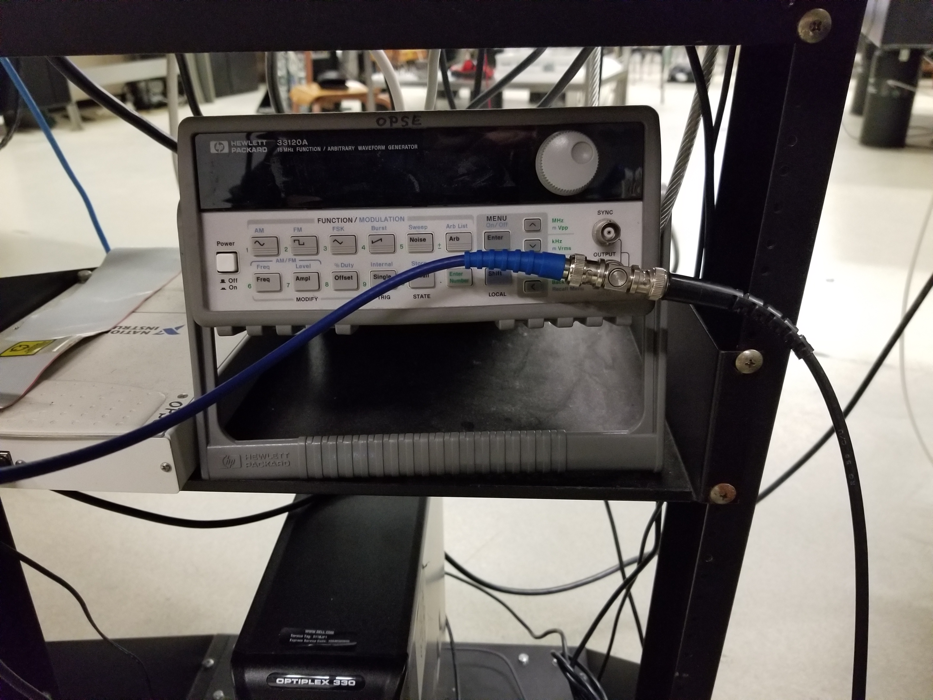
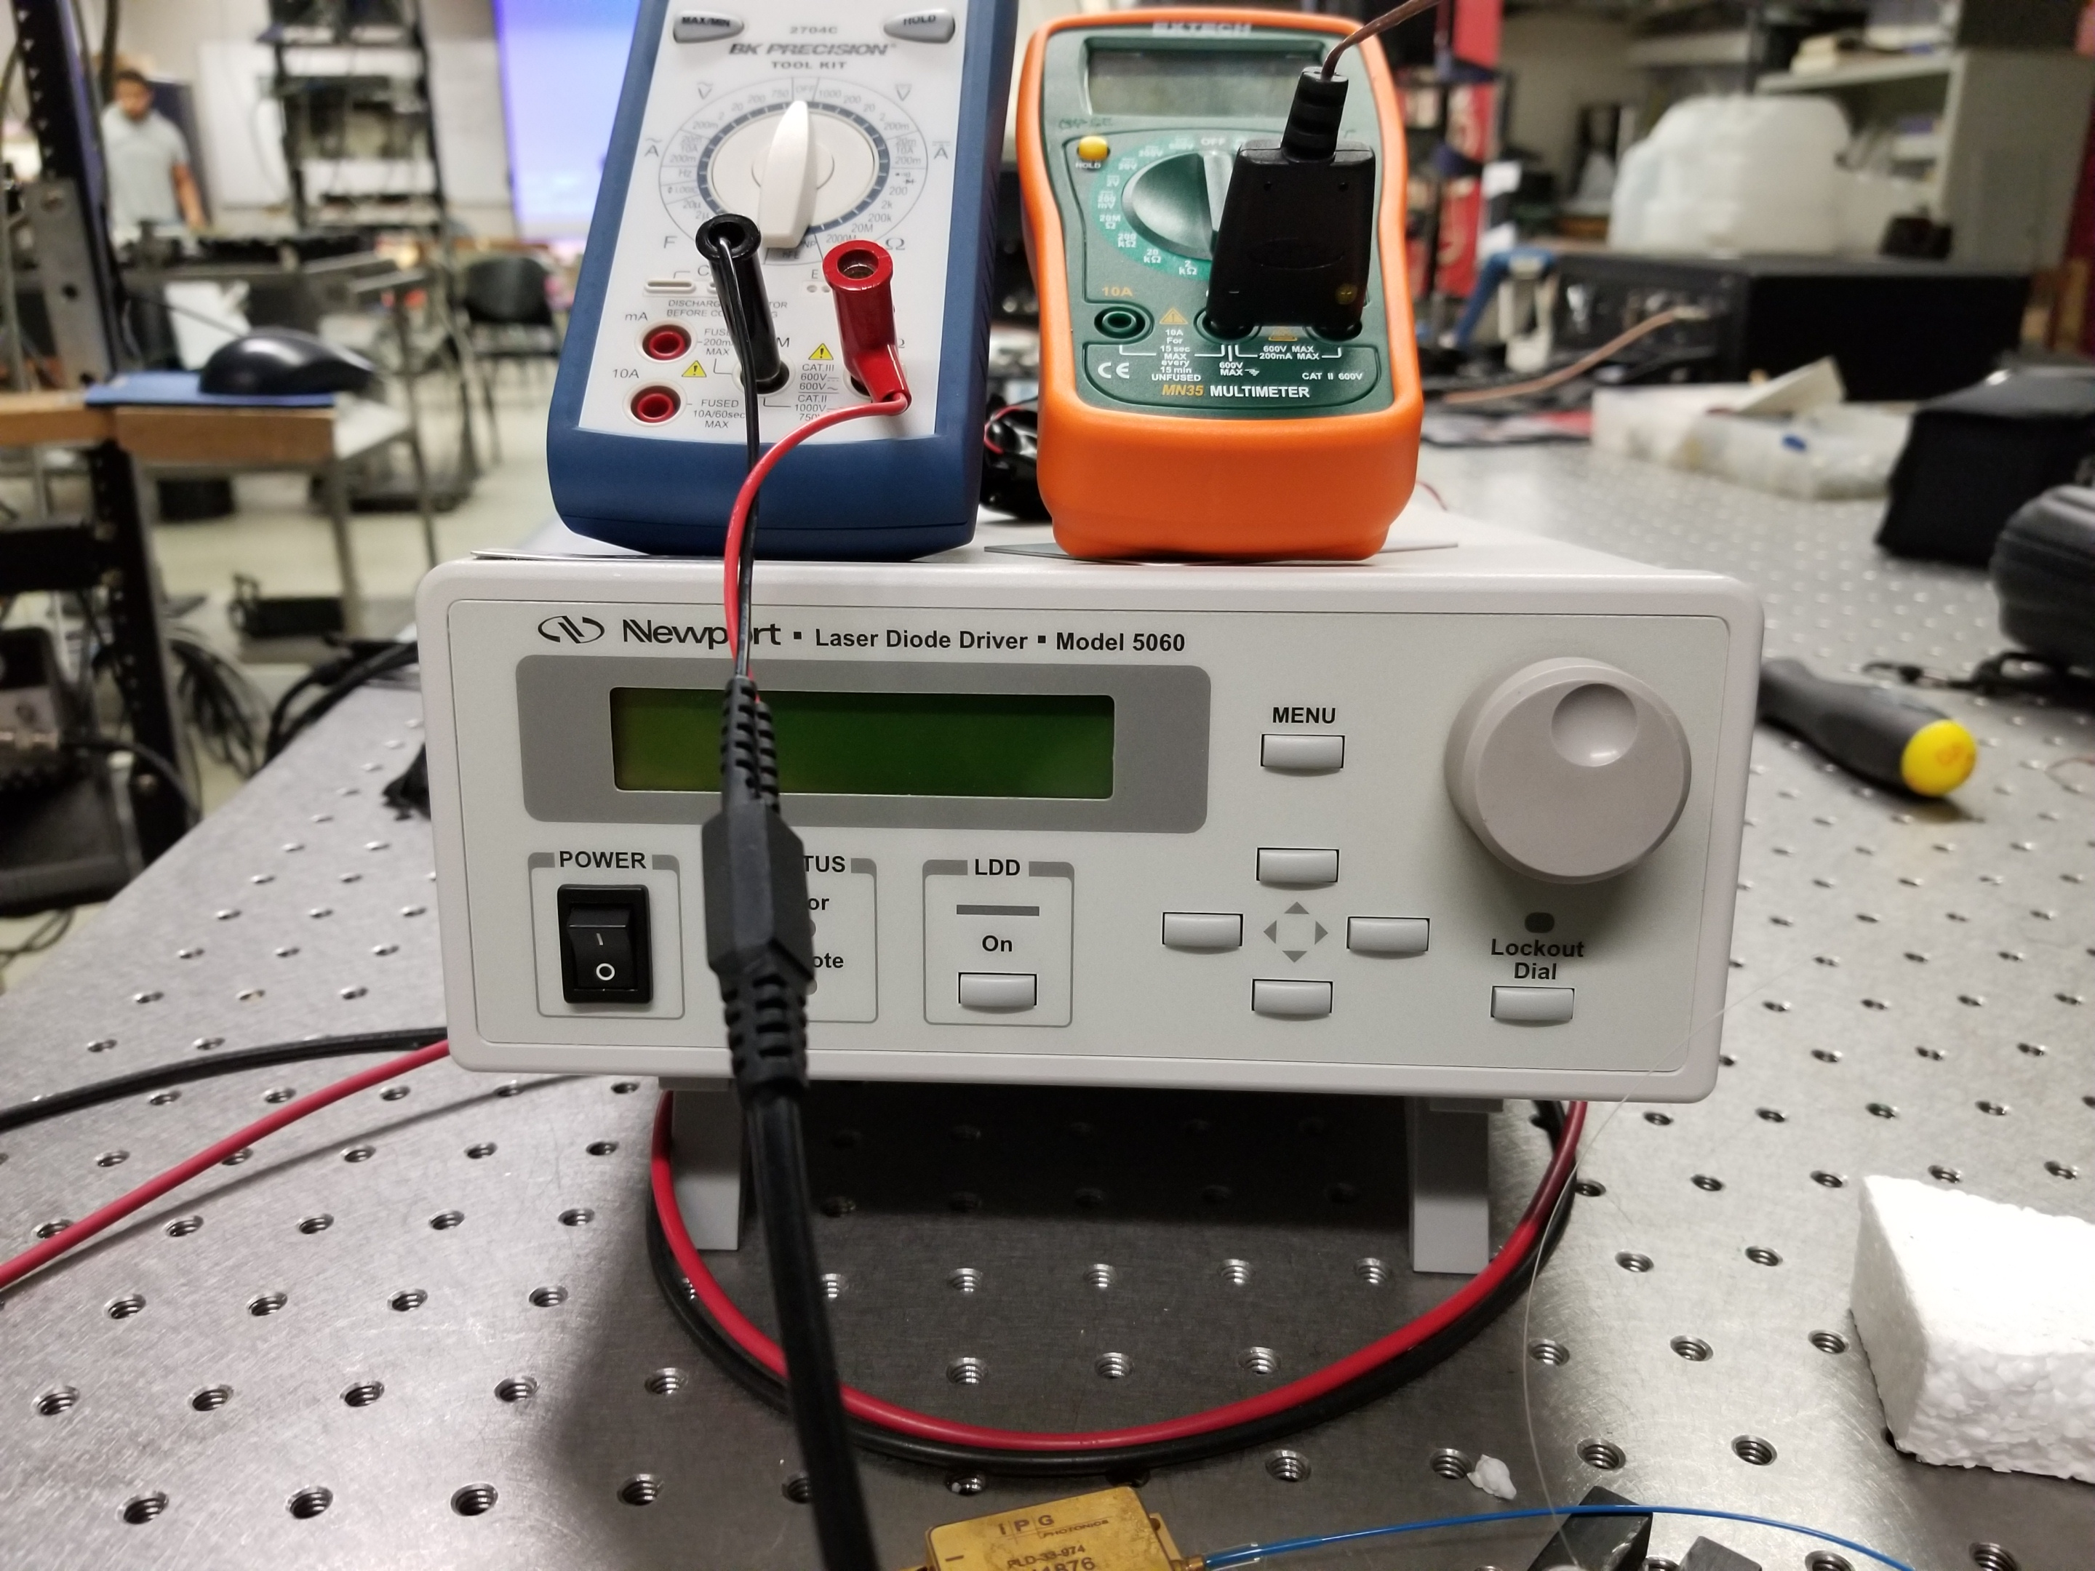
Results waveform generator
Waveform Generator is connected to the oscilloscope on Channel 1
Laser Diode Driver is connected on Channel 2
Frequency at 5.6Hz the waves are synchronized
Frequency at 50.6Hz the waves are beginning to distort
Frequency at 150.6Hz the waves are no longer in synch.
There is limit to what the detector can receive.

Slide 11
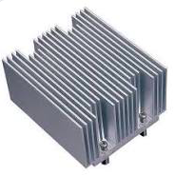
Conclusion
Errors
Fluctuating multimeter
Inaccurate readings from working quickly
Fluctuating temperature
High temperature does lower laser power
How to fix/improve: heat sinks, liquid cooling, air cooling.

Slide 12
References
[1] Ab-Rahman, M. (2012). The Effect of Temperature on the Performance of Uncooled Semiconductor Laser Diode in Optical Network. Journal of Computer Science,8(1), 84-88. doi:10.3844/jcssp.2012.84.88
[2] Pankove, J. I. (1968). Temperature Dependence of Emission Efficiency and Lasing Thresholds in Laser Diodes. Journal of Quantum Electronics, 4, 4th ser., 119-122.

Slide 13
Thank you for your attention
If you have any further questions, please reach out to me at
nlc4@njit.edu

